Slide 1
Lecture #5: Cross-Validation and Regularization (Ridge and LASSO)

Slide 2
Lecture Outline
Brief Review
- Overfitting
- Variable Selection
Cross Validation
Regularization: LASSO and Ridge
Regularization Methods: A Comparison

Slide 3
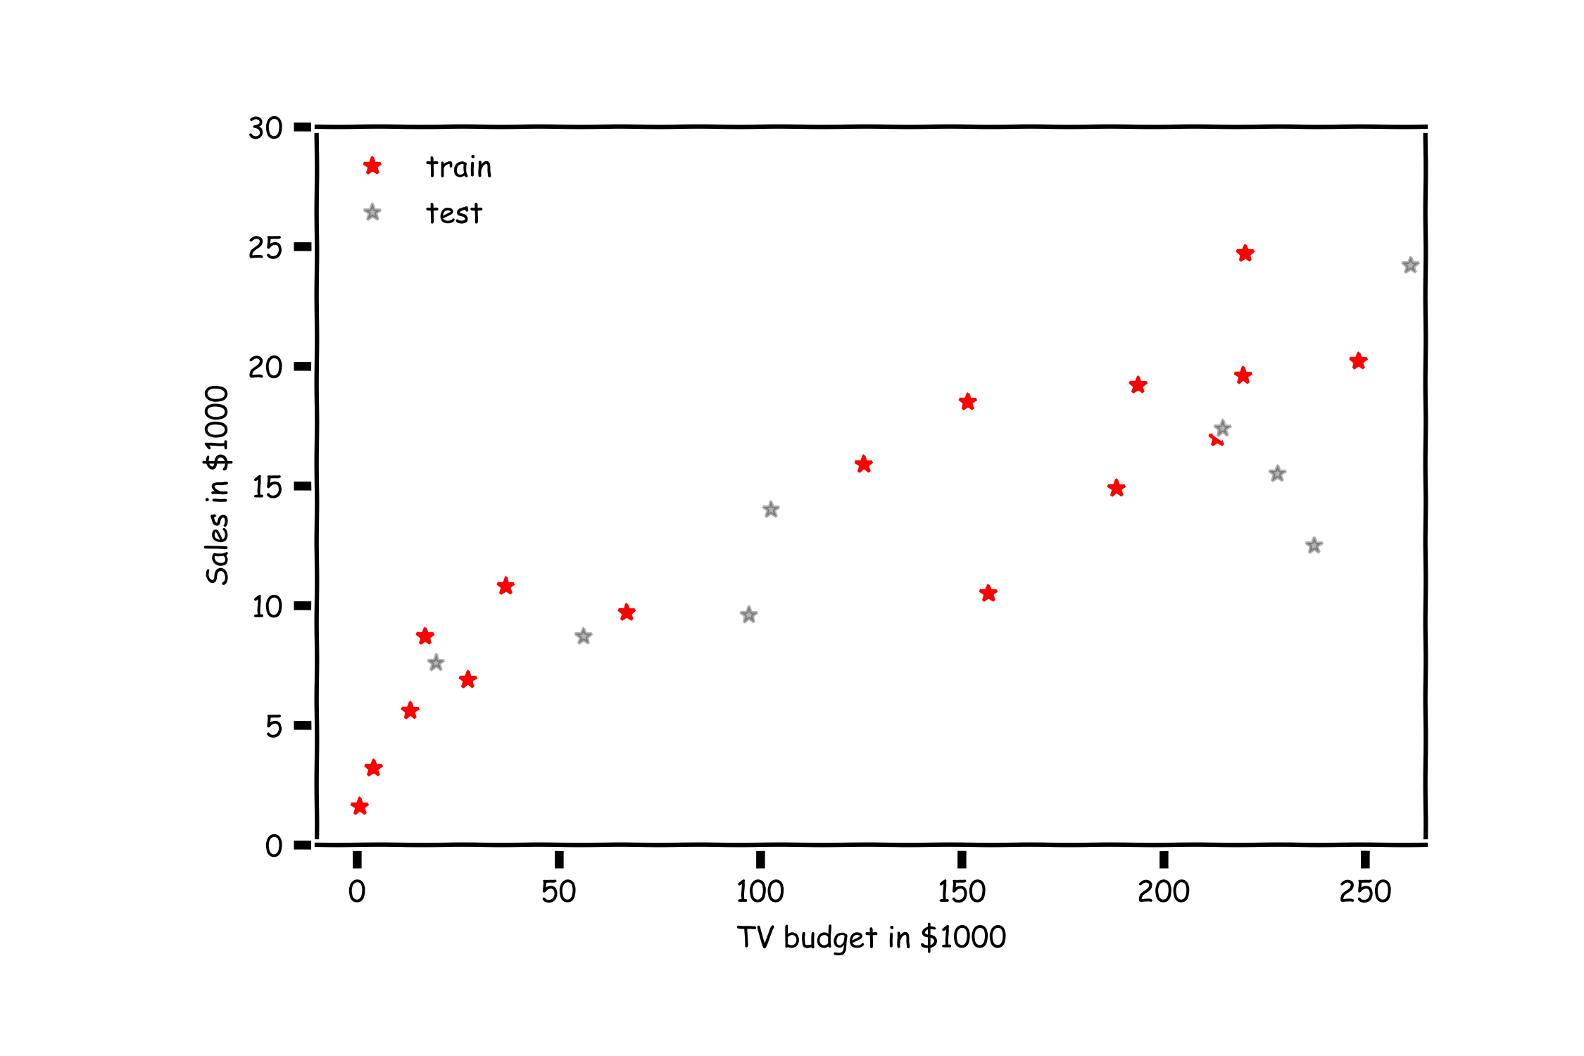
Overfitting

Slide 4
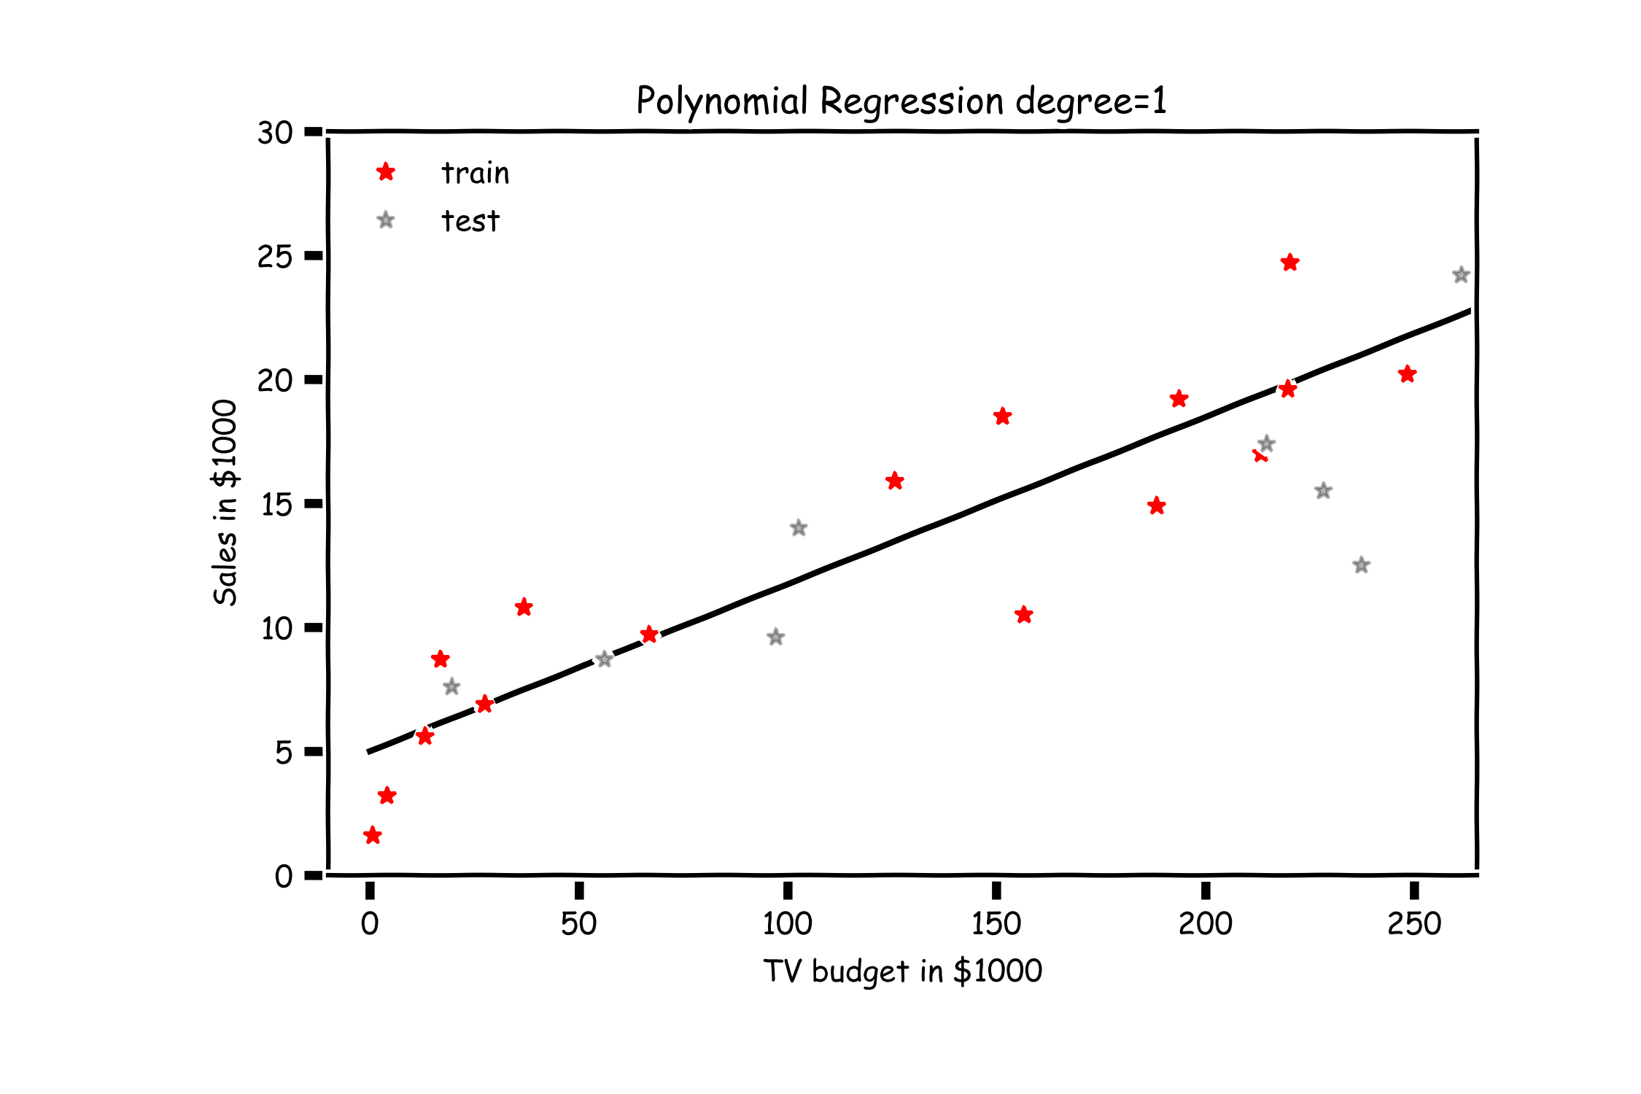
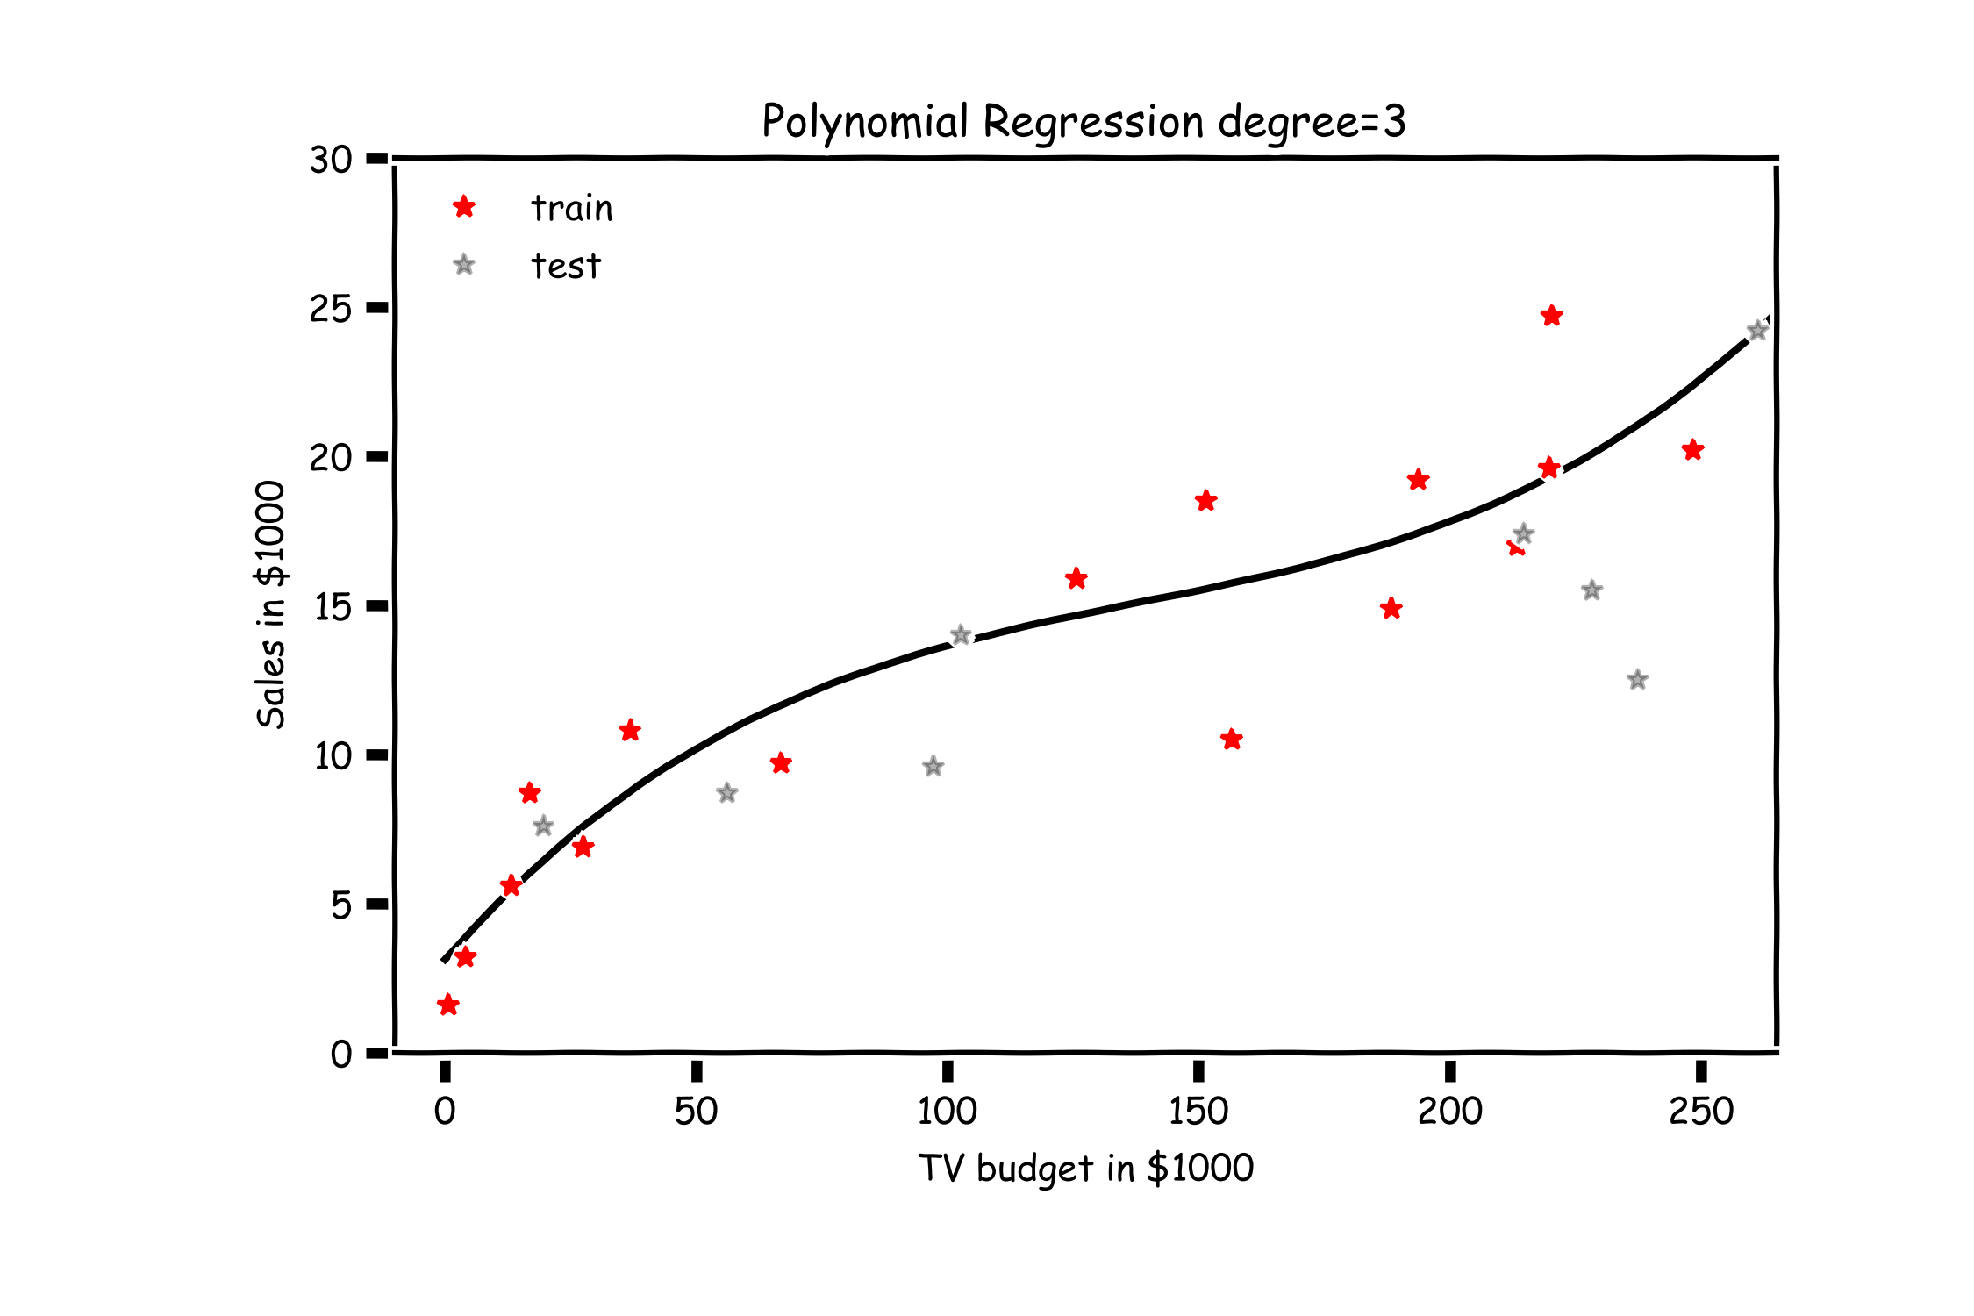
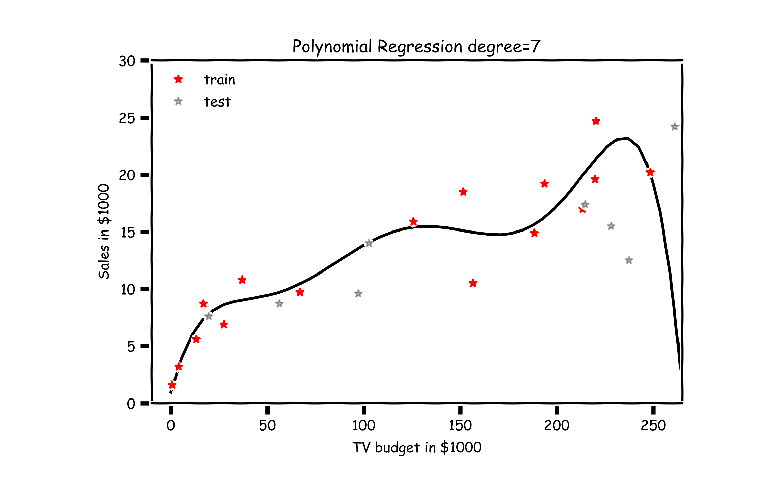
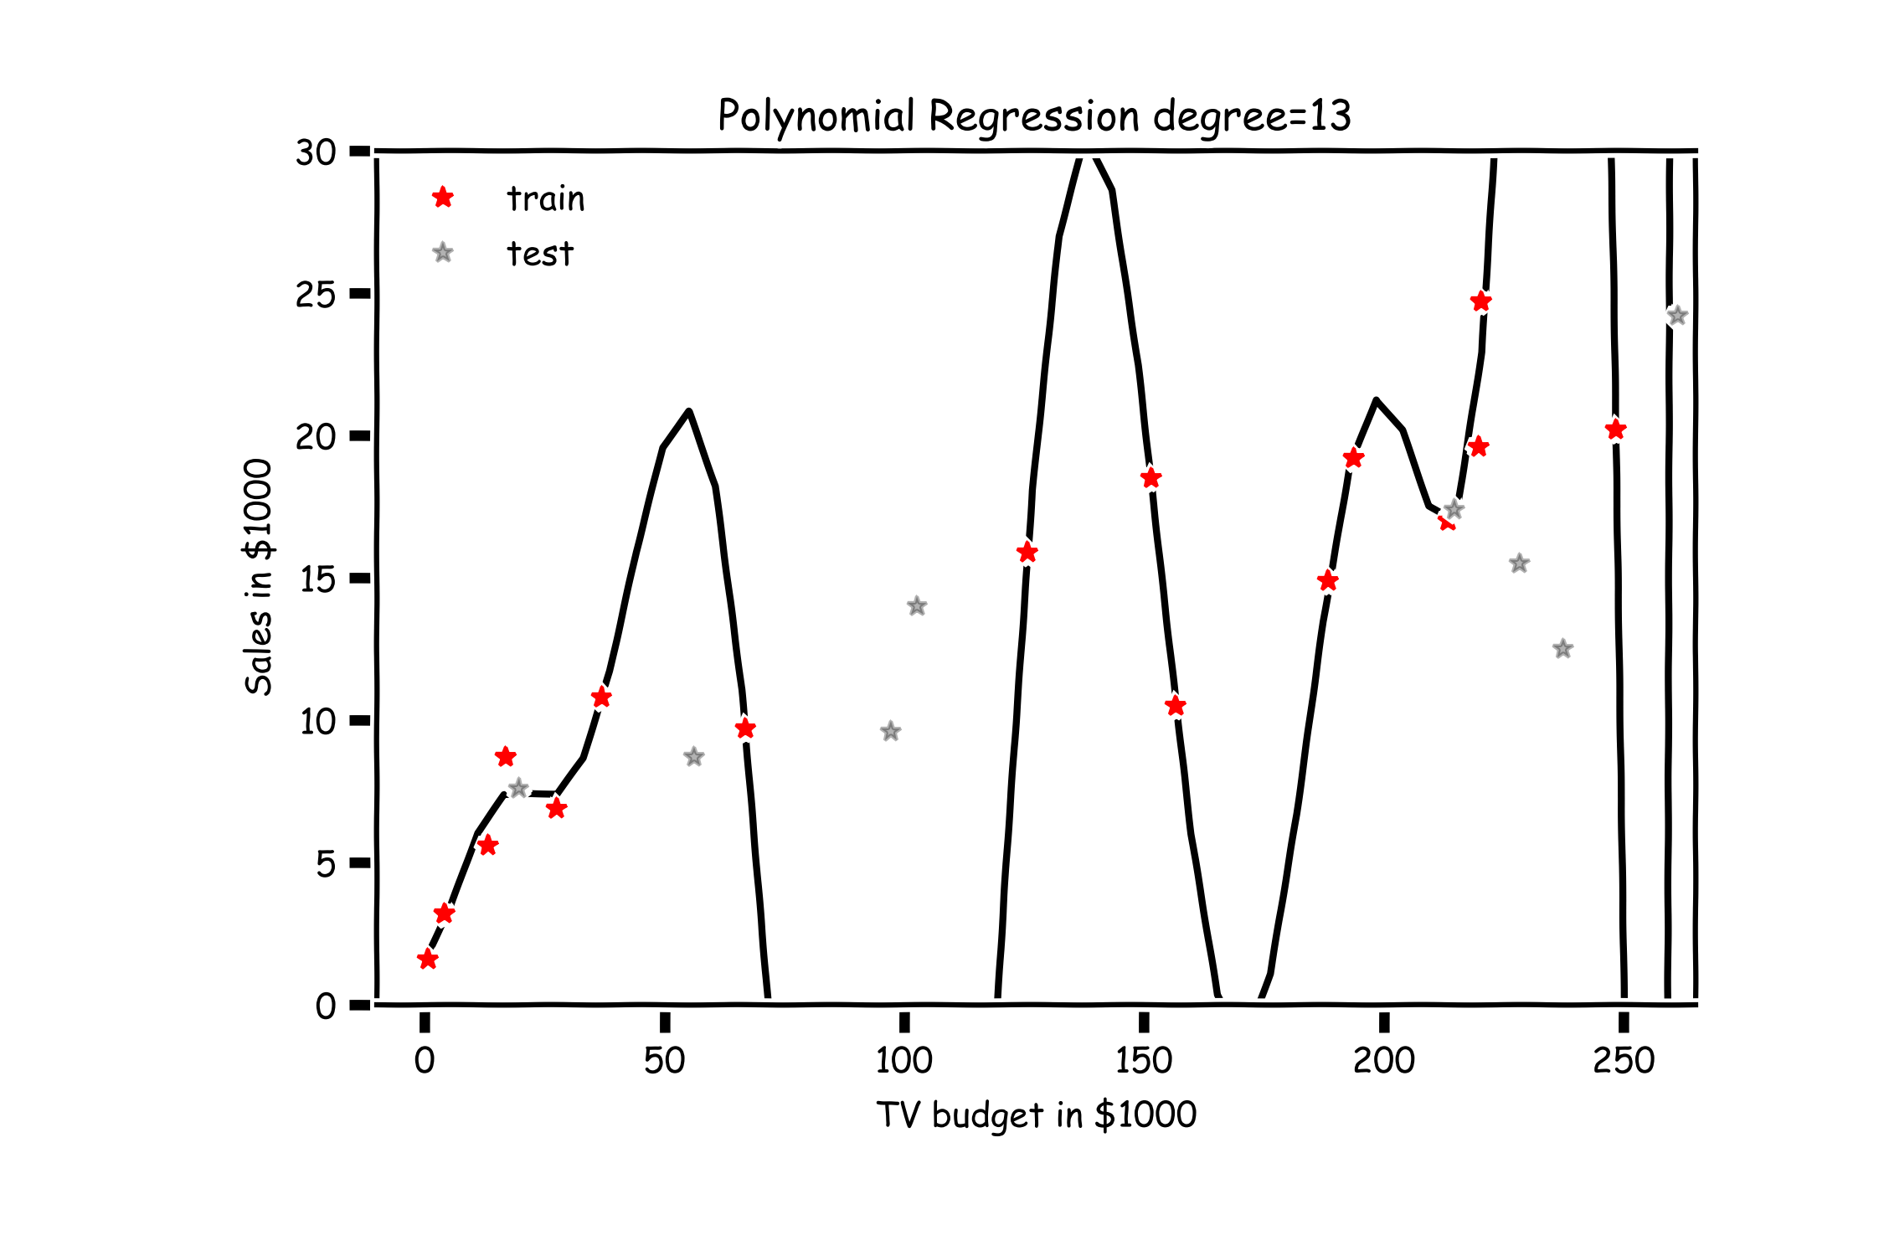
Overfitting with polynomials

Slide 5
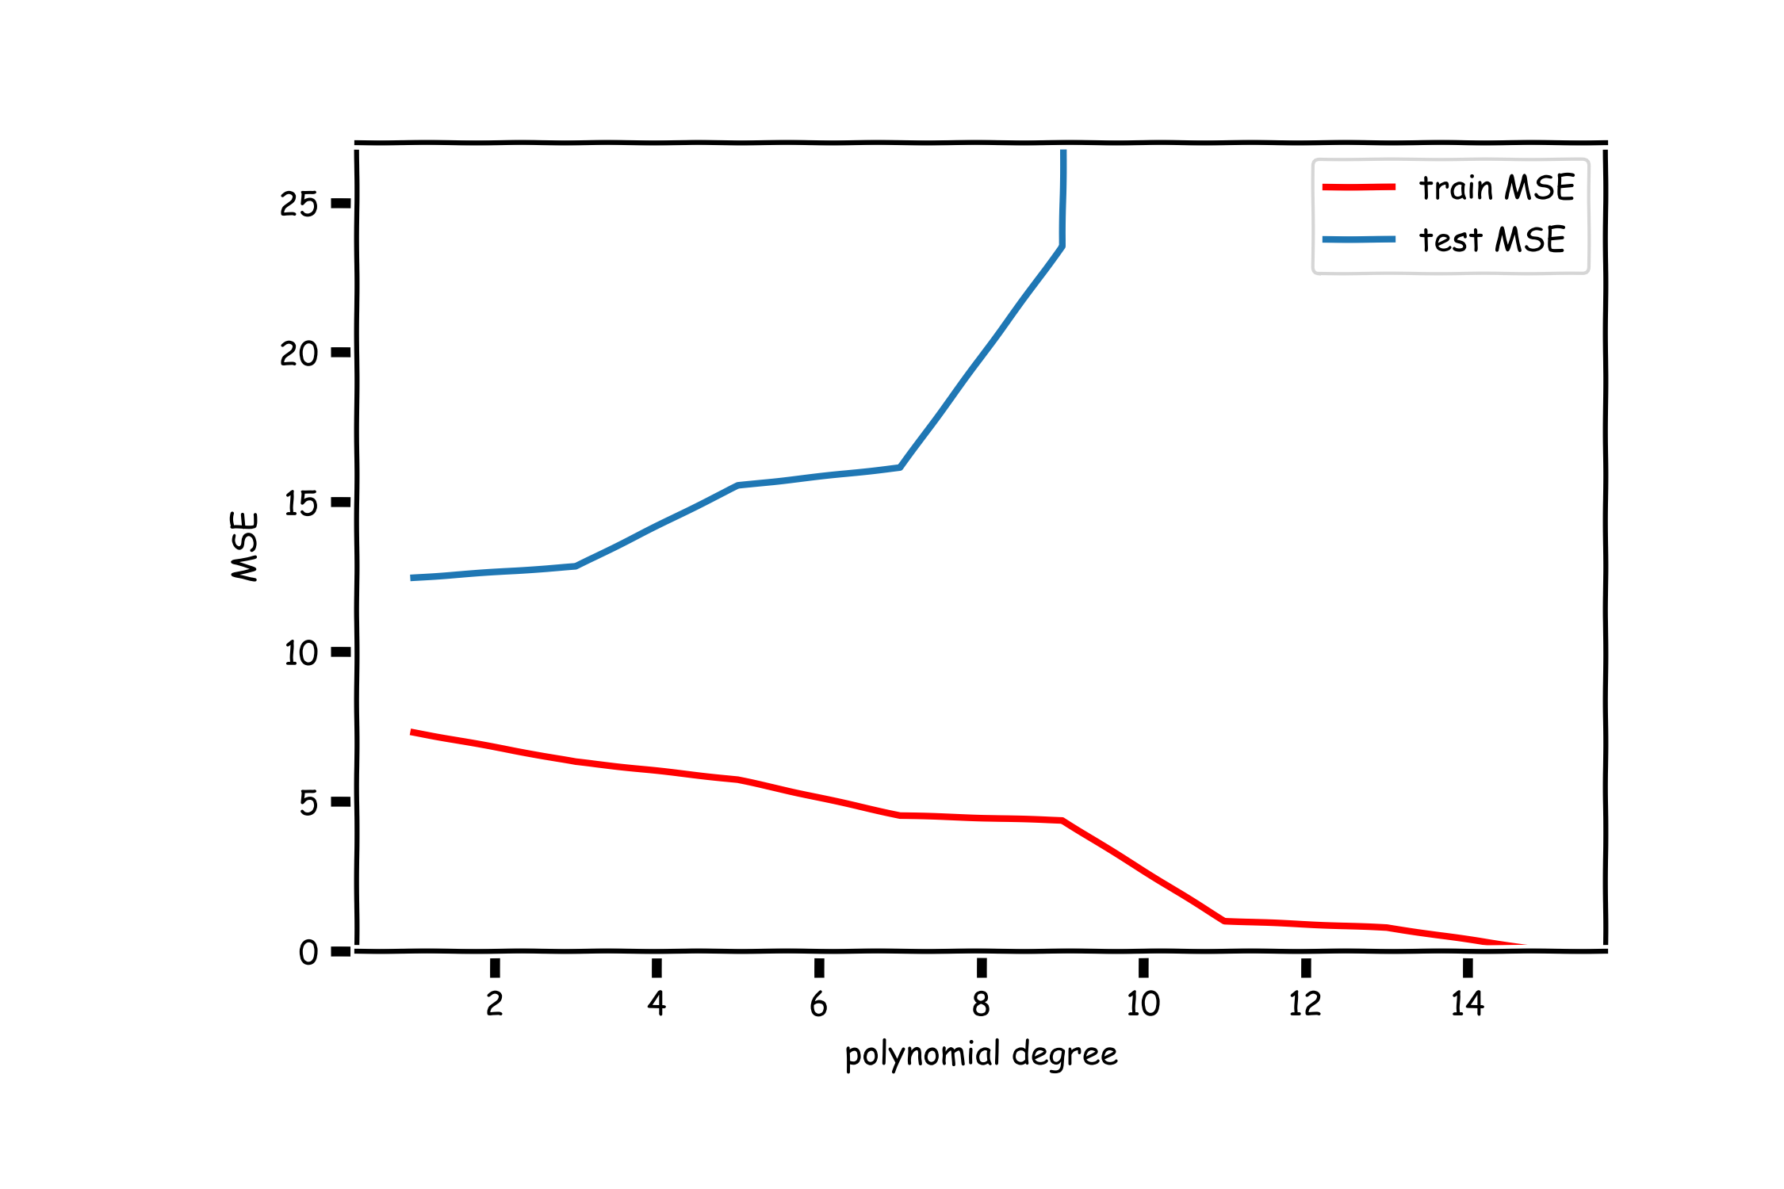
Validation/Test

Slide 6
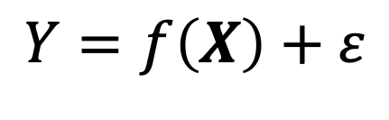
Overfitting
In statistical modeling, overfitting is the production of an analysis that corresponds too closely or exactly to a particular set of data, and may therefore fail to properly capture the true relationships or predict future (aka, out-of-sample) observations reliably.
You can think of overfitting as fitting to the particular intricacies of the residuals in the training set and not just the true signal in the relationship between the response and the predictors:
Think:
$$Y=f\left(X\right)+ε$$

Slide 7
Train-Validation-Test
Question:
What is a more honest representation of the performance of the model?
R2_test(degree=10) = 0.52
R2_train(degree=10) = 0.83

Slide 8
Variable Selection
Variable selection (also called model selection) is the application of a principled method to determine the complexity of the model, e.g. choosing a subset of predictors, choosing the degree of the polynomial model etc.
A strong motivation for performing model selection is to avoid overfitting, which we saw can happen when:
there are too many predictors:
the feature space has high dimensionality
the polynomial degree is too high
too many interaction terms are considered
the coefficients values are too extreme (high multicollinearity)

Slide 9
Stepwise Variable Selection and Validation Set Useage
Selecting optimal subsets of predictors (including choosing the degree of polynomial models) through:
stepwise variable selection - iteratively building an optimal subset of predictors by optimizing a fixed model evaluation metric each time,
validation - selecting an optimal model by evaluating each model on a validation/test sets.
We will also address the issue of discouraging extreme values in model parameters later.

Slide 10
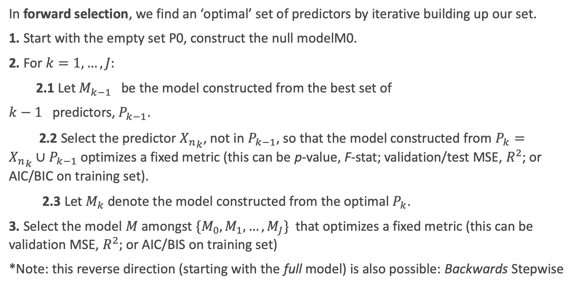
Stepwise Variable Selection: Forward method
In forward selection, we find an ‘optimal’ set of predictors by iterative building up our set.
1. Start with the empty set P0, construct the null modelM0.
2. For $k=1,…, J:$
2.1 Let $M_{k−1}$ be the model constructed from the best set of
$k−1$ predictors, $P_{k−1}$.
2.2 Select the predictor ${X_{n}}_{k}$, not in $P_{k−1}$, so that the model constructed from $P_{k}=$ ${X_{n}}_{k}∪P_{k−1}$ optimizes a fixed metric (this can be p-value, F-stat; validation/test MSE, $R^{2}$; or AIC/BIC on training set).
2.3 Let $M_{k}$ denote the model constructed from the optimal $P_{k}$.
3. Select the model $M$ amongst $\{M_{0}, M_{1},…, M_{J}\}$that optimizes a fixed metric (this can be validation MSE, $R^{2};$or AIC/BIS on training set)
*Note: this reverse direction (starting with the full model) is also possible: Backwards Stepwise

Slide 11
Lecture Outline
Brief Review
- Overfitting
- Variable Selection
Cross Validation
Regularization: LASSO and Ridge
Regularization Methods: A Comparison

Slide 12
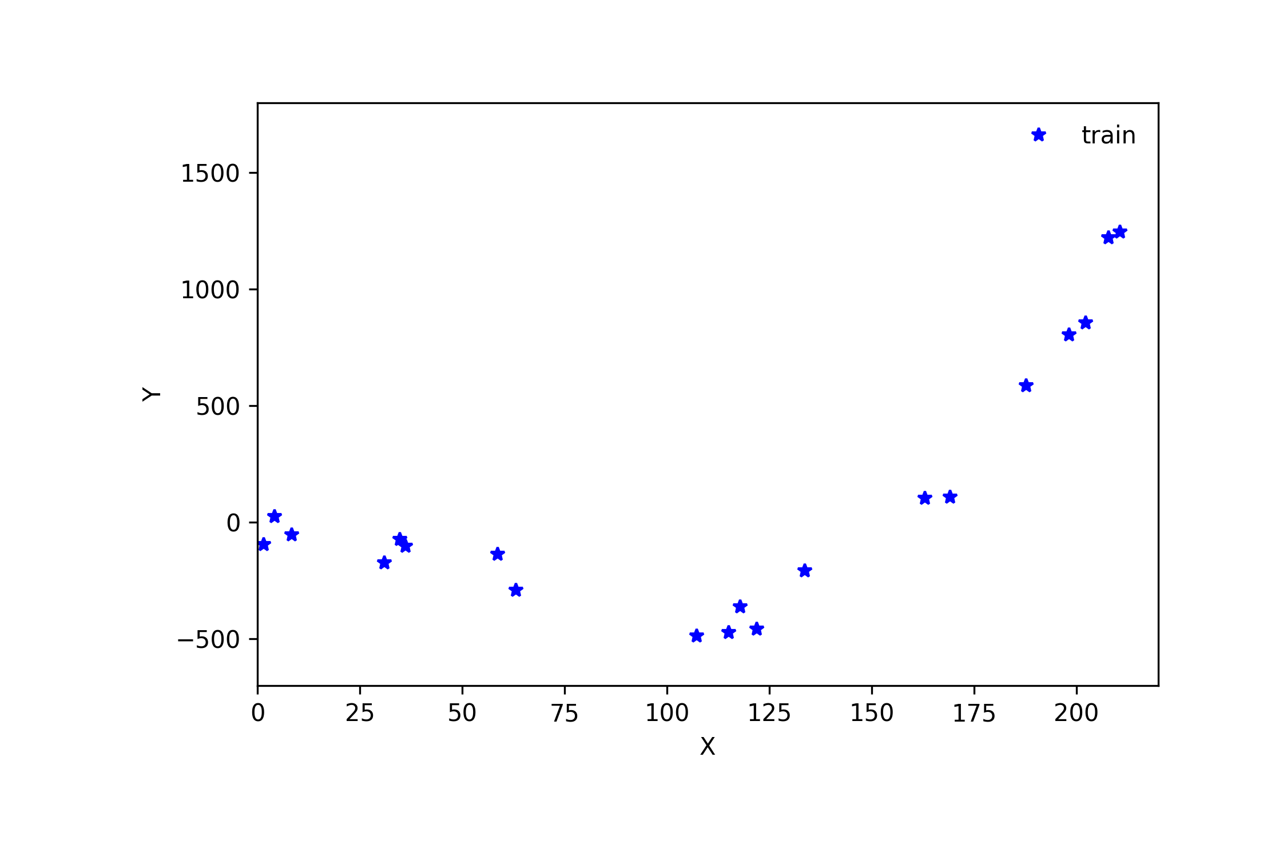
Cross Validation

Slide 13
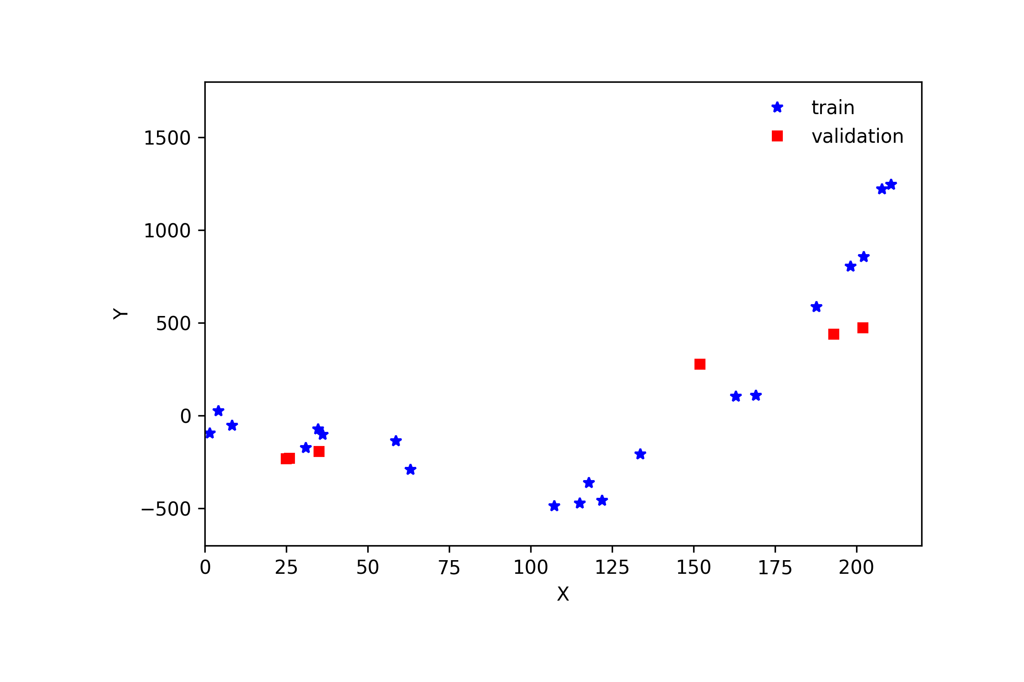
Cross Validation

Slide 14
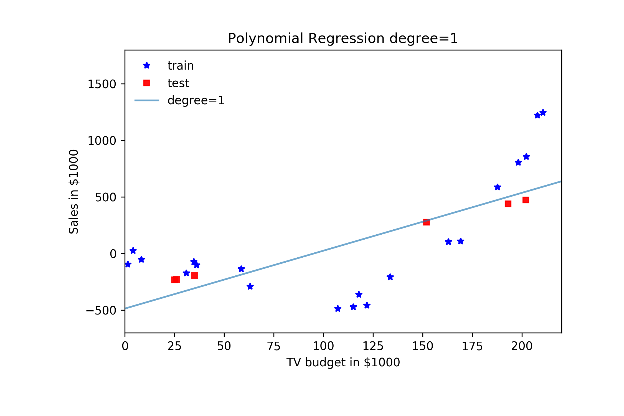
Cross Validation

Slide 15
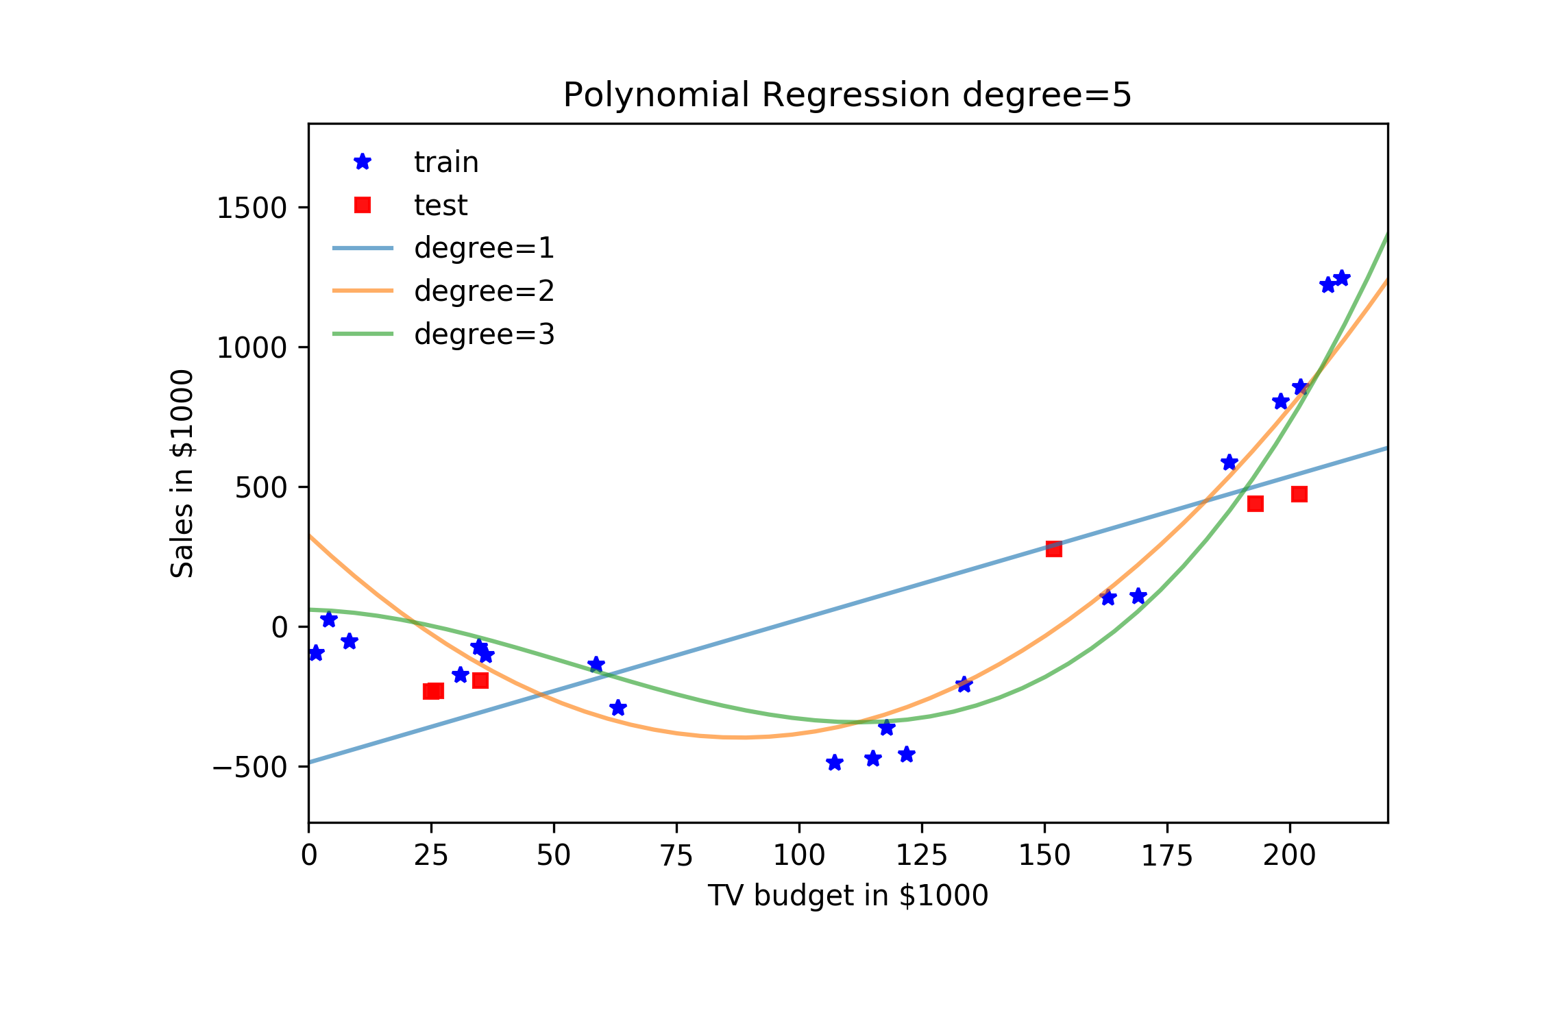
Cross Validation

Slide 16
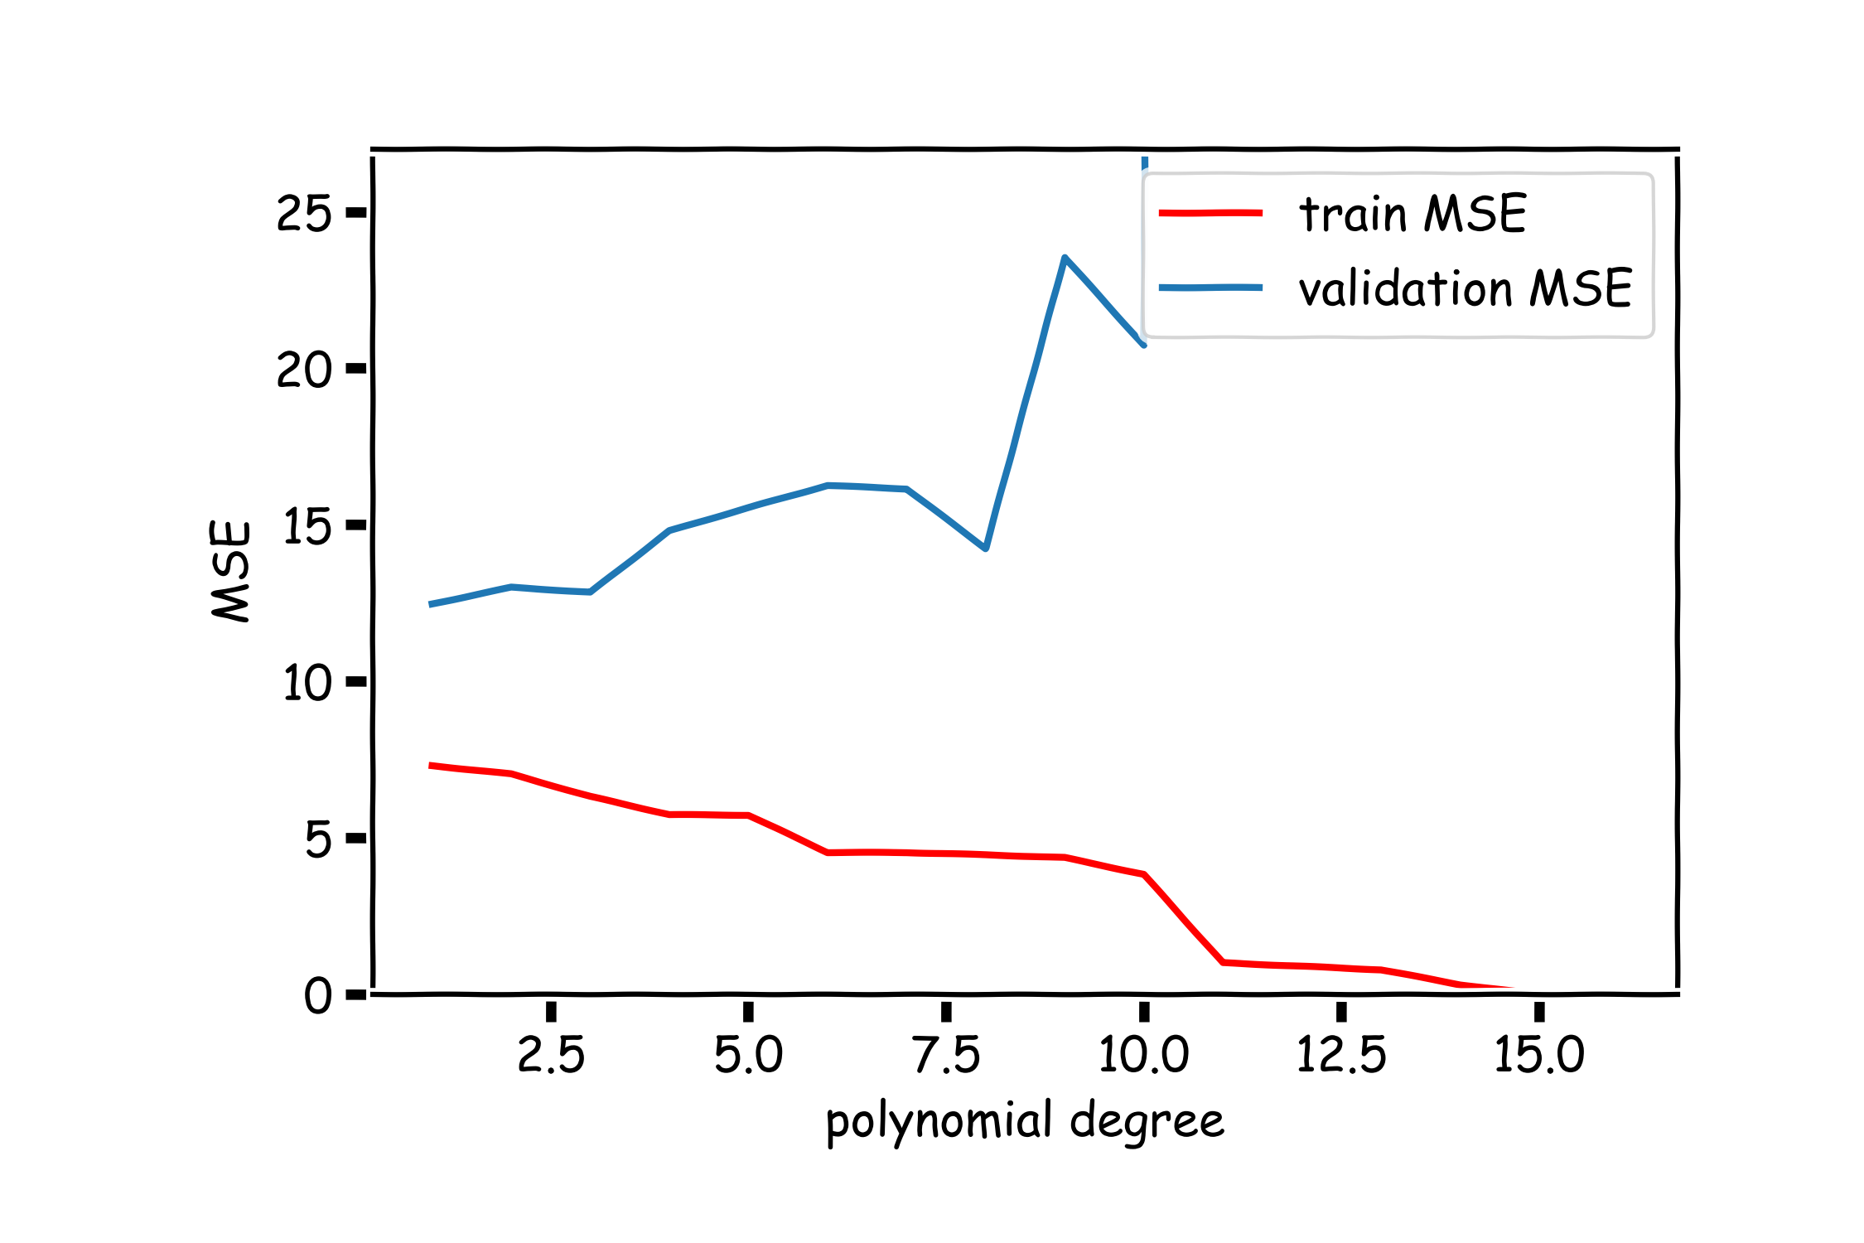
Validation

Slide 17
Cross Validation: Motivation
Using a single validation or test set to select amongst multiple models can be problematic - there is the possibility of overfitting to the test set.
One solution to the problems raised by using a single validation set is to evaluate each model on multiple validation sets and average the validation performance.
One can randomly split the training set into training and validation multiple times but randomly creating these sets can create the scenario where important features of the data never appear in our random draws.

Slide 18
Cross Validation (K-fold)

Slide 19
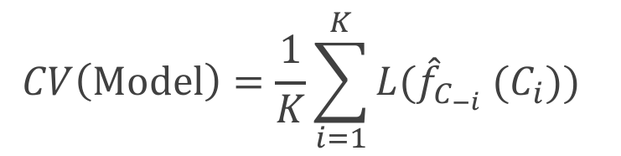
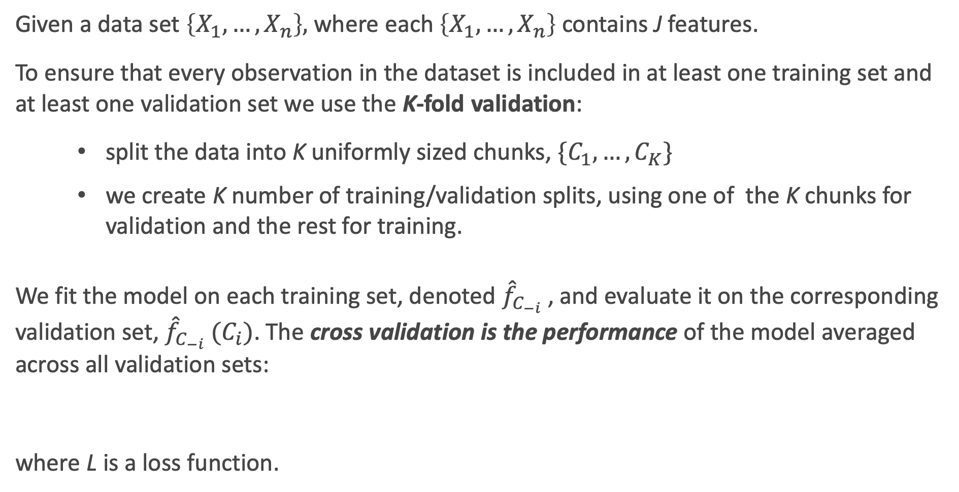
K-Fold Cross Validation
Given a data set $\left\{X_{1},…,X_{n}\right\},$ where each $\left\{X_{1},…,X_{n}\right\}$ contains J features.
To ensure that every observation in the dataset is included in at least one training set and at least one validation set we use the K-fold validation:
split the data into K uniformly sized chunks, $\{C_{1},…,C_{K}\}$
we create K number of training/validation splits, using one of the K chunks for validation and the rest for training.
We fit the model on each training set, denoted ${\hat{f}}_{C_{−i}}$ , and evaluate it on the corresponding validation set, ${\hat{f}}_{C_{−i}} (C_{i})$. The cross validation is the performance of the model averaged across all validation sets:
where L is a loss function.
$$CV\left(Model\right)=\frac{1}{K}\sum_{i=1}^{K}{{L(\hat{f}}_{C_{−i}} (C_{i})\text{)} }$$

Slide 20
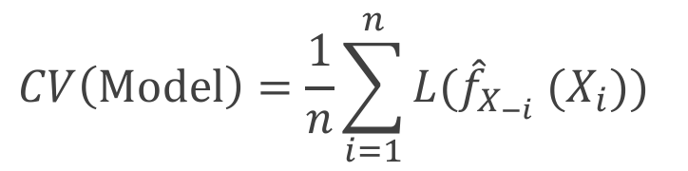
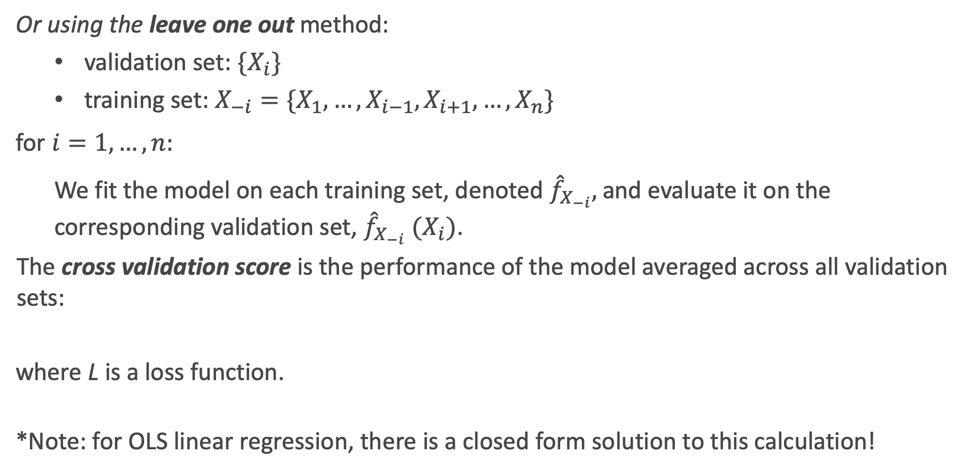
Leave-One-Out Cross Validation
Or using the leave one out method:
validation set: ${\{X}_{i}\}$
training set: $X_{−i}=\{X_{1}, …,X_{i−1},X_{i+1}, …, X_{n}\}$
for ${i=1,…,n: }_{}$
We fit the model on each training set, denoted ${\hat{f}}_{X_{−i}},$and evaluate it on the corresponding validation set, ${\hat{f}}_{X_{−i}} (X_{i})$.
The cross validation score is the performance of the model averaged across all validation sets:
where L is a loss function.
*Note: for OLS linear regression, there is a closed form solution to this calculation!
$$CV\left(Model\right)=\frac{1}{n}\sum_{i=1}^{n}{{L(\hat{f}}_{X_{−i}} (X_{i})\text{)} }$$

Slide 21
Random Subsets (sometimes called bootstrapped) Cross-Validation
An alternative approach to doing k-fold cross-validation is to do many random subsets of random selected observations.
For example, from the original training set, 80% of the observations may be randomly selected to train the models, and the other 20% are left to validate/evaluate the models to choose between them.
Then this is done a 2nd time for a new random subset of 80% of the observations. And then a 3rd time, etc.
What is the advantage to doing CV this way? To doing k-fold?

Slide 22
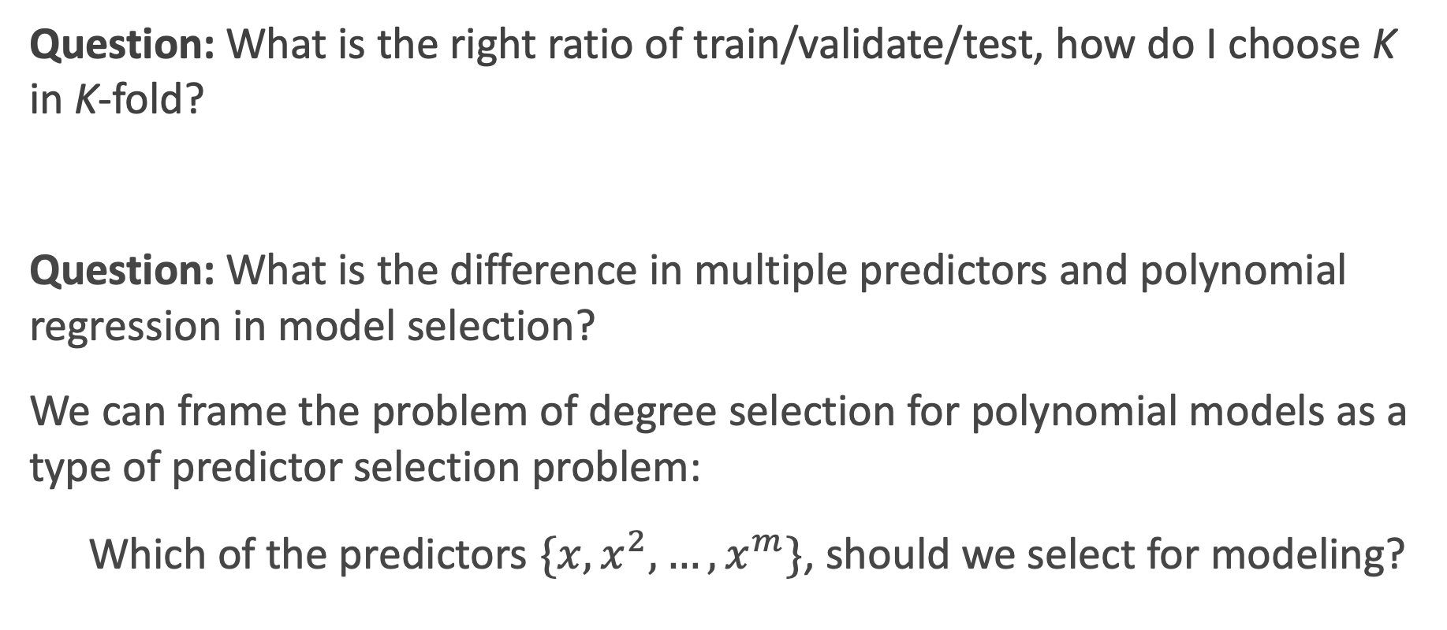
Predictor Selection: Cross Validation
Question: What is the right ratio of train/validate/test, how do I choose K in K-fold?
Question: What is the difference in multiple predictors and polynomial regression in model selection?
We can frame the problem of degree selection for polynomial models as a type of predictor selection problem:
Which of the predictors $\{x, x^{2},…, x^{m}\}$, should we select for modeling?

Slide 23

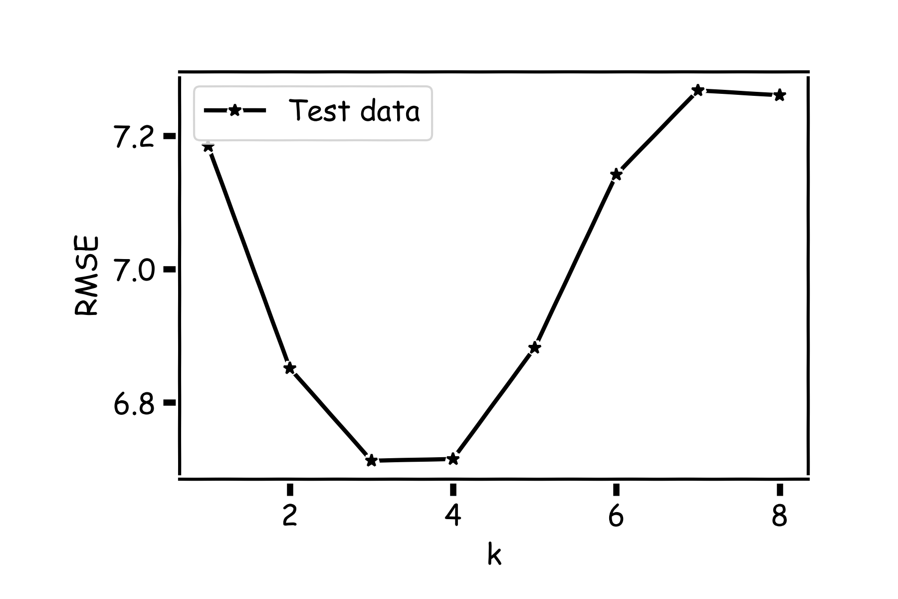
k-NN Revisited

Slide 24
k-NN Revisited
Recall our first simple, intuitive,
non-parametric model for regression –
the k-NN model. We saw that it is vitally
important to select an appropriate k for
the data.
If the k is too small then the model is very sensitive to noise (since a new prediction is based on very few observed neighbors), and if the k is too large, the model tends towards making constant predictions.
A principled way to choose k is through K-fold cross validation.

Slide 25
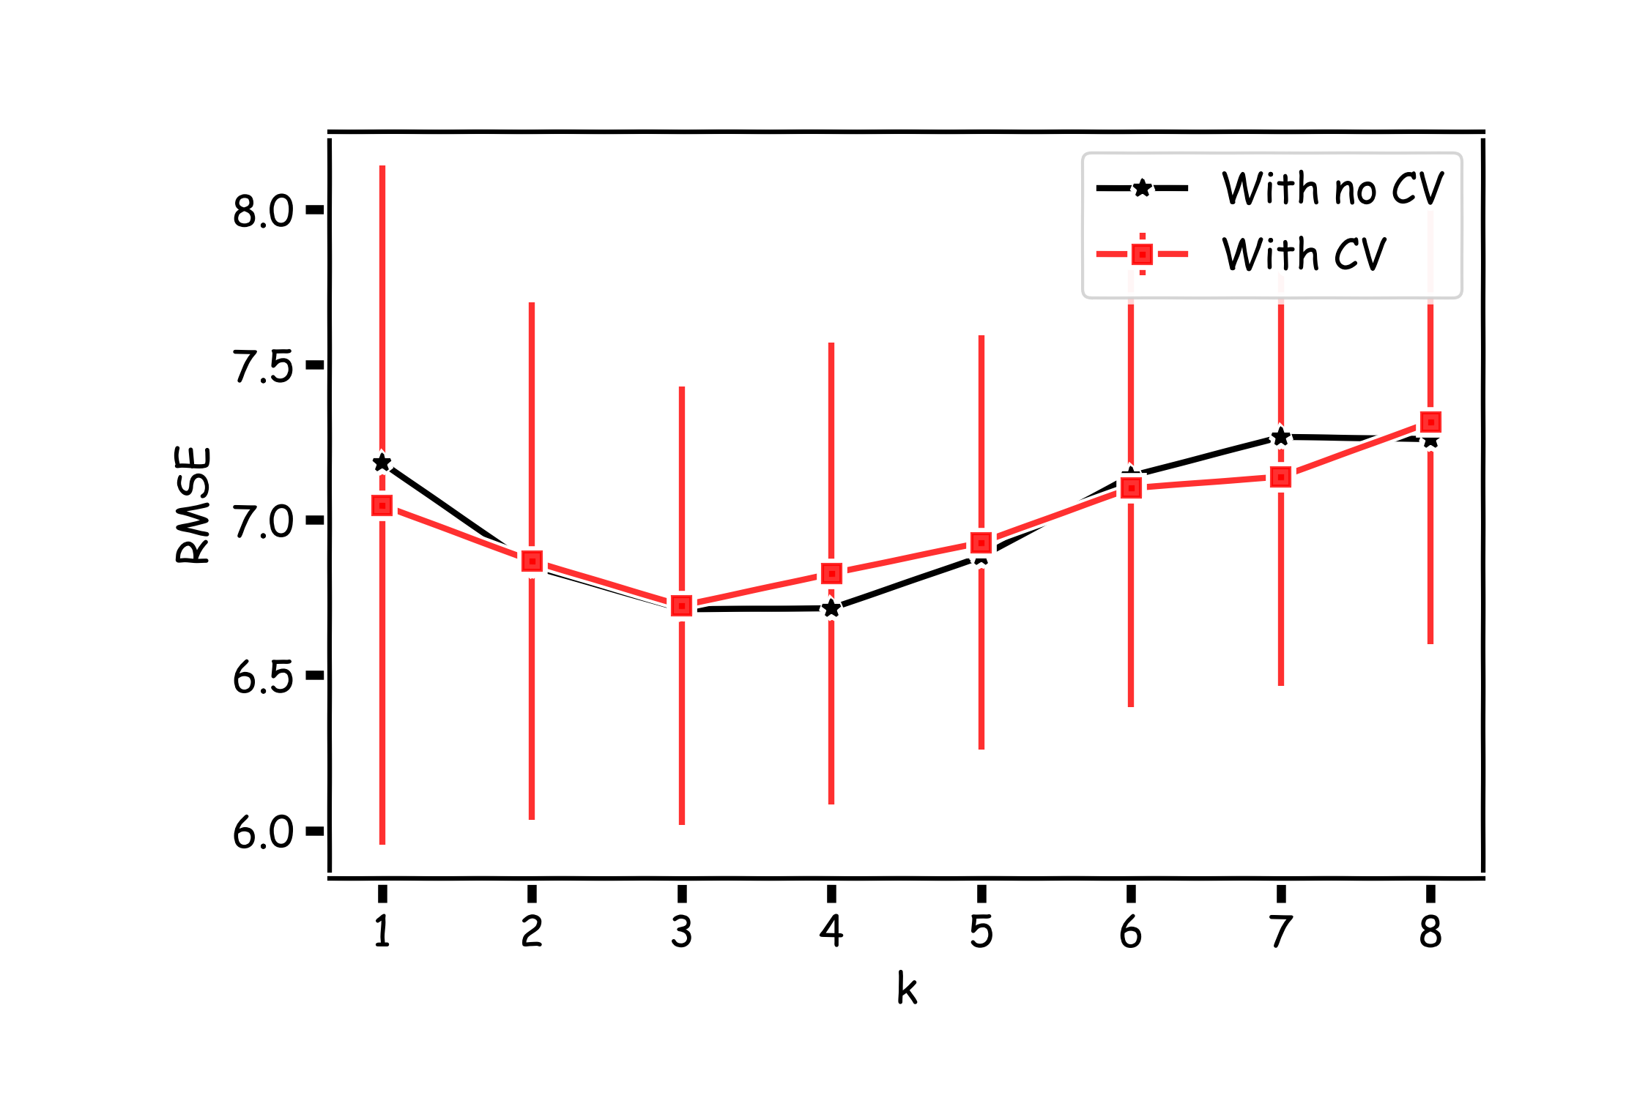
k-fold with k=100 folds

Slide 26
What happens to the test set?
Note: there is still usefulness to a single test set.
Cross-validation is great to choose between many models or tune a hyperparameter (which we will see in a bit). But the error of the model is likely under-evaluated. Why?
This is where the original test set comes in to play:

Slide 27
Lecture Outline
Brief Review
- Overfitting
- Variable Selection
Cross Validation
Regularization: LASSO and Ridge
Regularization Methods: A Comparison

Slide 28
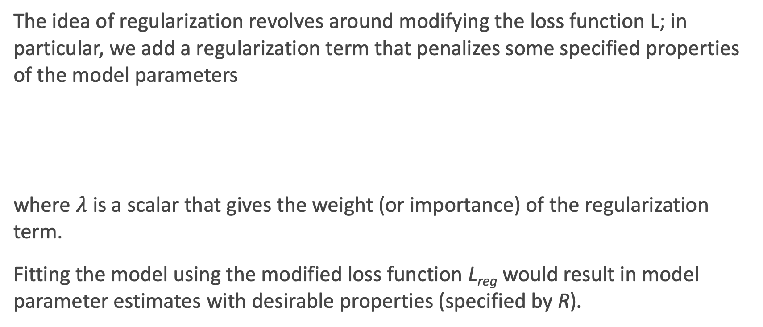
Regularization: An Overview
The idea of regularization revolves around modifying the loss function L; in particular, we add a regularization term that penalizes some specified properties of the model parameters
where $λ$ is a scalar that gives the weight (or importance) of the regularization term.
Fitting the model using the modified loss function L_{reg} would result in model parameter estimates with desirable properties (specified by R).

Slide 29
LASSO Regression
Since we wish to discourage extreme values in model parameter, we need to choose a regularization term that penalizes parameter magnitudes. For our loss function, we will again use MSE.
Together our regularized loss function is:
Note that is the l₁ norm of the vector β

Slide 30
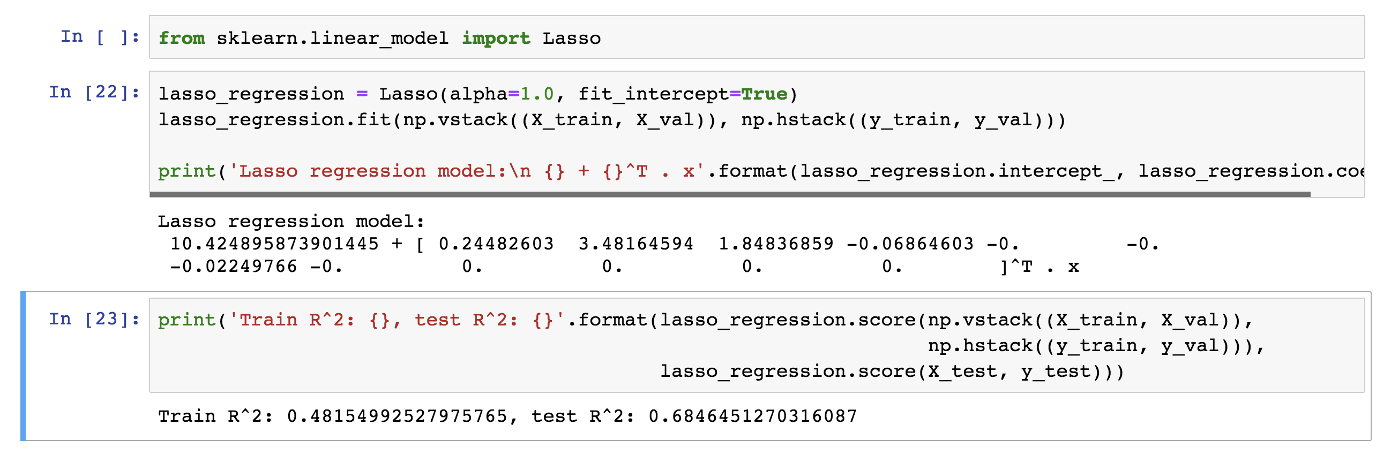
LASSO Regression
Hence, we often say that L_{LASSO} is the loss function for l₁ regularization.
Finding the model parameters β_{LASSO} that minimize the l₁ regularized loss function is called LASSO regression.

Slide 31
Ridge Regression
Alternatively, we can choose a regularization term that penalizes the squares of the parameter magnitudes. Then, our regularized loss function is:
Note that is the l₂ norm of the vector β

Slide 32
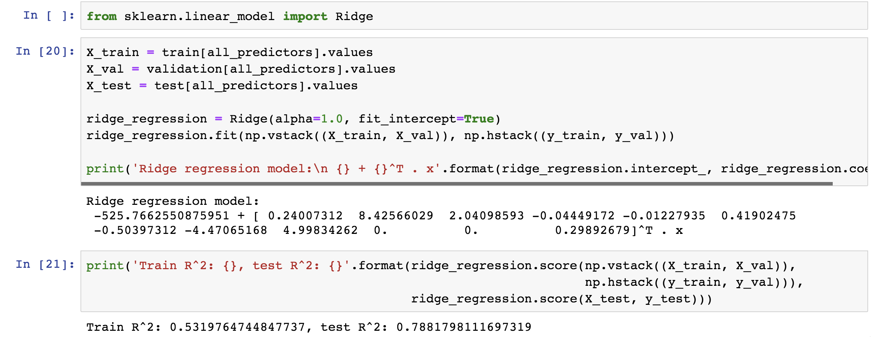
Ridge Regression
Hence, we often say that L_{ridge} is the loss function for l₂ regularization.
Finding the model parameters β_{ridge} that minimize the l₂ regularized loss function is called ridge regression.

Slide 33
Choosing λ
In both ridge and LASSO regression, we see that the larger our choice of the regularization parameter λ, the more heavily we penalize large values in β,
If λ is close to zero, we recover the MSE, i.e. ridge and LASSO regression is just ordinary regression.
If λ is sufficiently large, the MSE term in the regularized loss function will be insignificant and the regularization term will force β_{ridge} and β_{LASSO} to be close to zero.
To avoid ad-hoc choices, we should select λ using cross-validation.

Slide 34
Ridge - Computational complexity
Solution to ridge regression:
The solution of the Ridge/Lasso regression involves three steps
Select λ
Find the minimum of the ridge/Lasso regression cost function (using linear algebra) as with the multiple regression and record the R² on the test set.
Find the λ that gives the largest R²

Slide 35
Standardizing predictors
Standardizing your predictors (a linear transformation so that they each have mean = 0 and sd = 1) can be an important consideration when modeling. Why?
How will each of the methods we have learned so far be affected by first standardizing all predictors?
How should binary predictors be handled? How about interaction and polynomial terms?
The default should be to standardize in k-NN and LASSO/Ridge!

Slide 36
Lecture Outline
Brief Review
- Overfitting
- Variable Selection
Cross Validation
Regularization: LASSO and Ridge
Regularization Methods: A Comparison

Slide 37
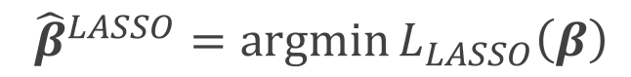
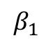
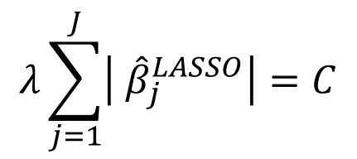
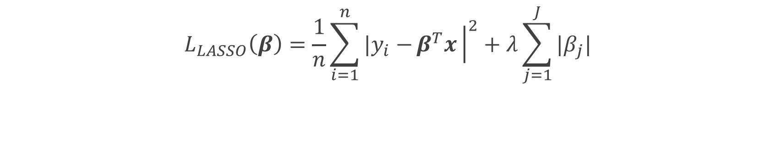
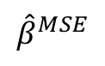
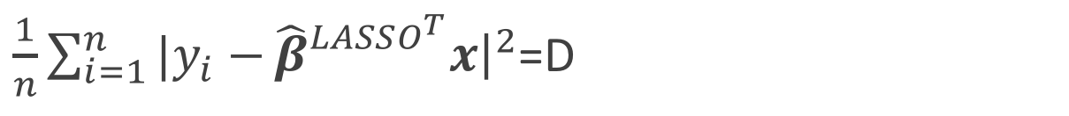
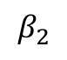
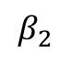
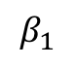
The Geometry of Regularization (LASSO)
$$L_{LASSO}\left(β\right)=\frac{1}{n}\sum_{i=1}^{n}{|y_{i}−}β^{T}x{\left.​\right|}^{2}+λ\sum_{j=1}^{J}{|β_{j}|}$$
$${\hat{β}}^{LASSO}=argmin{L_{LASSO}\left(β\right)}$$
$$λ\sum_{j=1}^{J}{\left| {\hat{β}}_{j}^{LASSO}\right|=C}$$
$\frac{1}{n}\sum_{i=1}^{n}{|y_{i}−}{\hat{β}}_{}^{LASSO^{T}}x{\left.​\right|}^{2}$=D
$$β_{2}$$
$$β_{2}$$
C
$${\hat{β}}^{MSE}$$
MSE=D
C
$$β_{1}$$
$$β_{1}$$

Slide 38
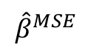
The Geometry of Regularization (LASSO)
$$β_{2}$$
$$β_{2}$$
$$β_{2}$$
$${\hat{β}}^{MSE}$$
MSE=D
C
C
$${\hat{β}}^{MSE}$$
MSE=D
C
C
$$β_{1}$$
$$β_{1}$$
$$β_{1}$$

Slide 39
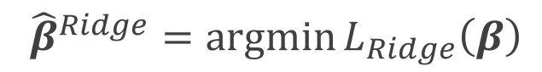
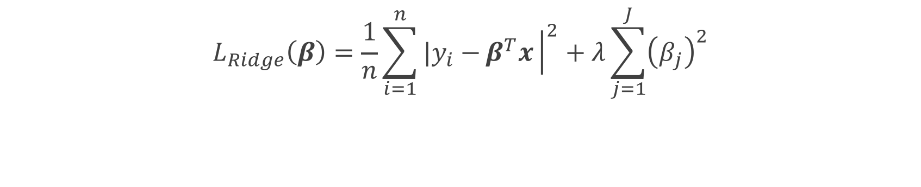
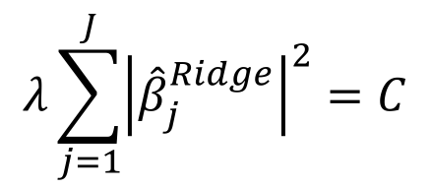
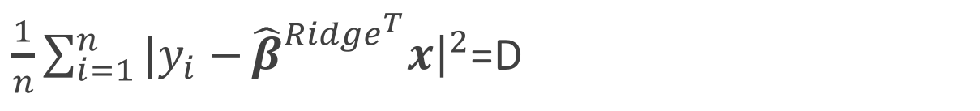
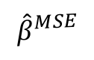
The Geometry of Regularization (Ridge)
$$L_{Ridge}\left(β\right)=\frac{1}{n}\sum_{i=1}^{n}{|y_{i}−}β^{T}x{\left.​\right|}^{2}+λ\sum_{j=1}^{J}{{\left(β_{j}\right)}^{2}}$$
$${\hat{β}}^{Ridge}=argmin{L_{Ridge}\left(β\right)}$$
$$λ\sum_{j=1}^{J}{{\left|{\hat{β}}_{j}^{Ridge}\right|}^{2}=C}$$
$\frac{1}{n}\sum_{i=1}^{n}{|y_{i}−}{\hat{β}}_{}^{{Ridge}^{T}}x{\left.​\right|}^{2}$=D
$$β_{2}$$
$$β_{2}$$
$${\hat{β}}^{MSE}$$
MSE=D
C
$$β_{1}$$
$$β_{1}$$

Slide 40
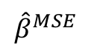
The Geometry of Regularization (Ridge)
$$β_{2}$$
$${\hat{β}}^{MSE}$$
MSE=D
C
$$β_{1}$$

Slide 41
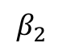
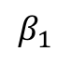
The Geometry of Regularization
$$β_{2}$$
$$β_{2}$$
$${\hat{β}}^{MSE}$$
MSE=D
$${\hat{β}}^{MSE}$$
MSE=D
C
C
C
$$β_{1}$$
$$β_{1}$$

Slide 42
Examples

Slide 43
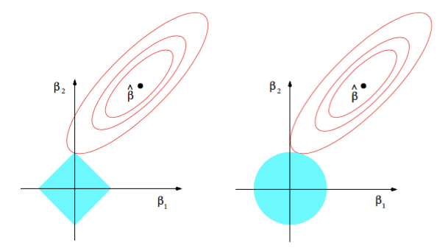
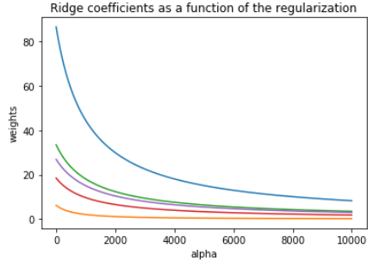
Ridge visualized
Ridge estimator
The ridge estimator is where the constraint and the loss intersect.
The values of the coefficients decrease as lambda increases, but they are not nullified.

Slide 44
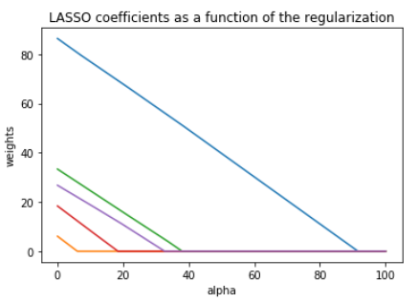
LASSO visualized
Lasso estimator
The Lasso estimator tends to zero out parameters as the OLS loss can easily intersect with the constraint on one of the axis.
The values of the coefficients decrease as lambda increases, and are nullified fast.

Slide 45
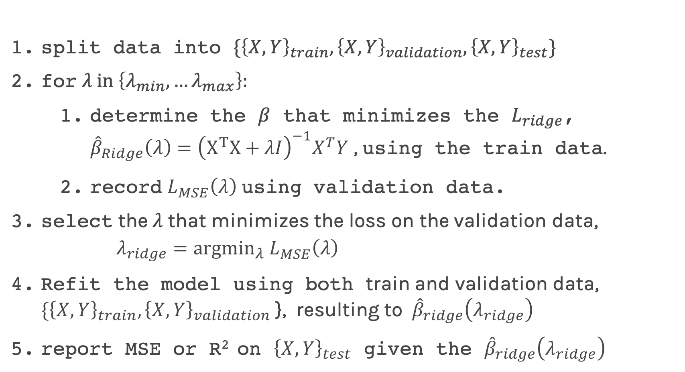
Ridge regularization with validation only: step by step
split data into $\{{\left\{X,Y\right\}}_{train},{\left\{X,Y\right\}}_{validation},{\left\{X,Y\right\}}_{test}\}$
for $λ in \left\{λ_{min},…λ_{max}\right\}:$
determine the $β$ that minimizes the $L_{ridge}$, ${\hat{β}}_{Ridge}\left(λ\right)={\left(X^{T}X+λI\right)}^{−1}X^{T}Y$ , using the train data.
record $L_{MSE}^{}\left(λ\right)$ using validation data.
select the $λ$that minimizes the loss on the validation data, $λ_{ridge}={argmin}_{λ} L_{MSE}^{}\left(λ\right)$
Refit the model using both train and validation data, $\{{\left\{X,Y\right\}}_{train},{\left\{X,Y\right\}}_{validation}$ }, resulting to ${\hat{β}}_{ridge}\left(λ_{ridge}\right)$
report MSE or R² on ${\left\{X,Y\right\}}_{test}$ given the ${\hat{β}}_{ridge}\left(λ_{ridge}\right)$

Slide 46
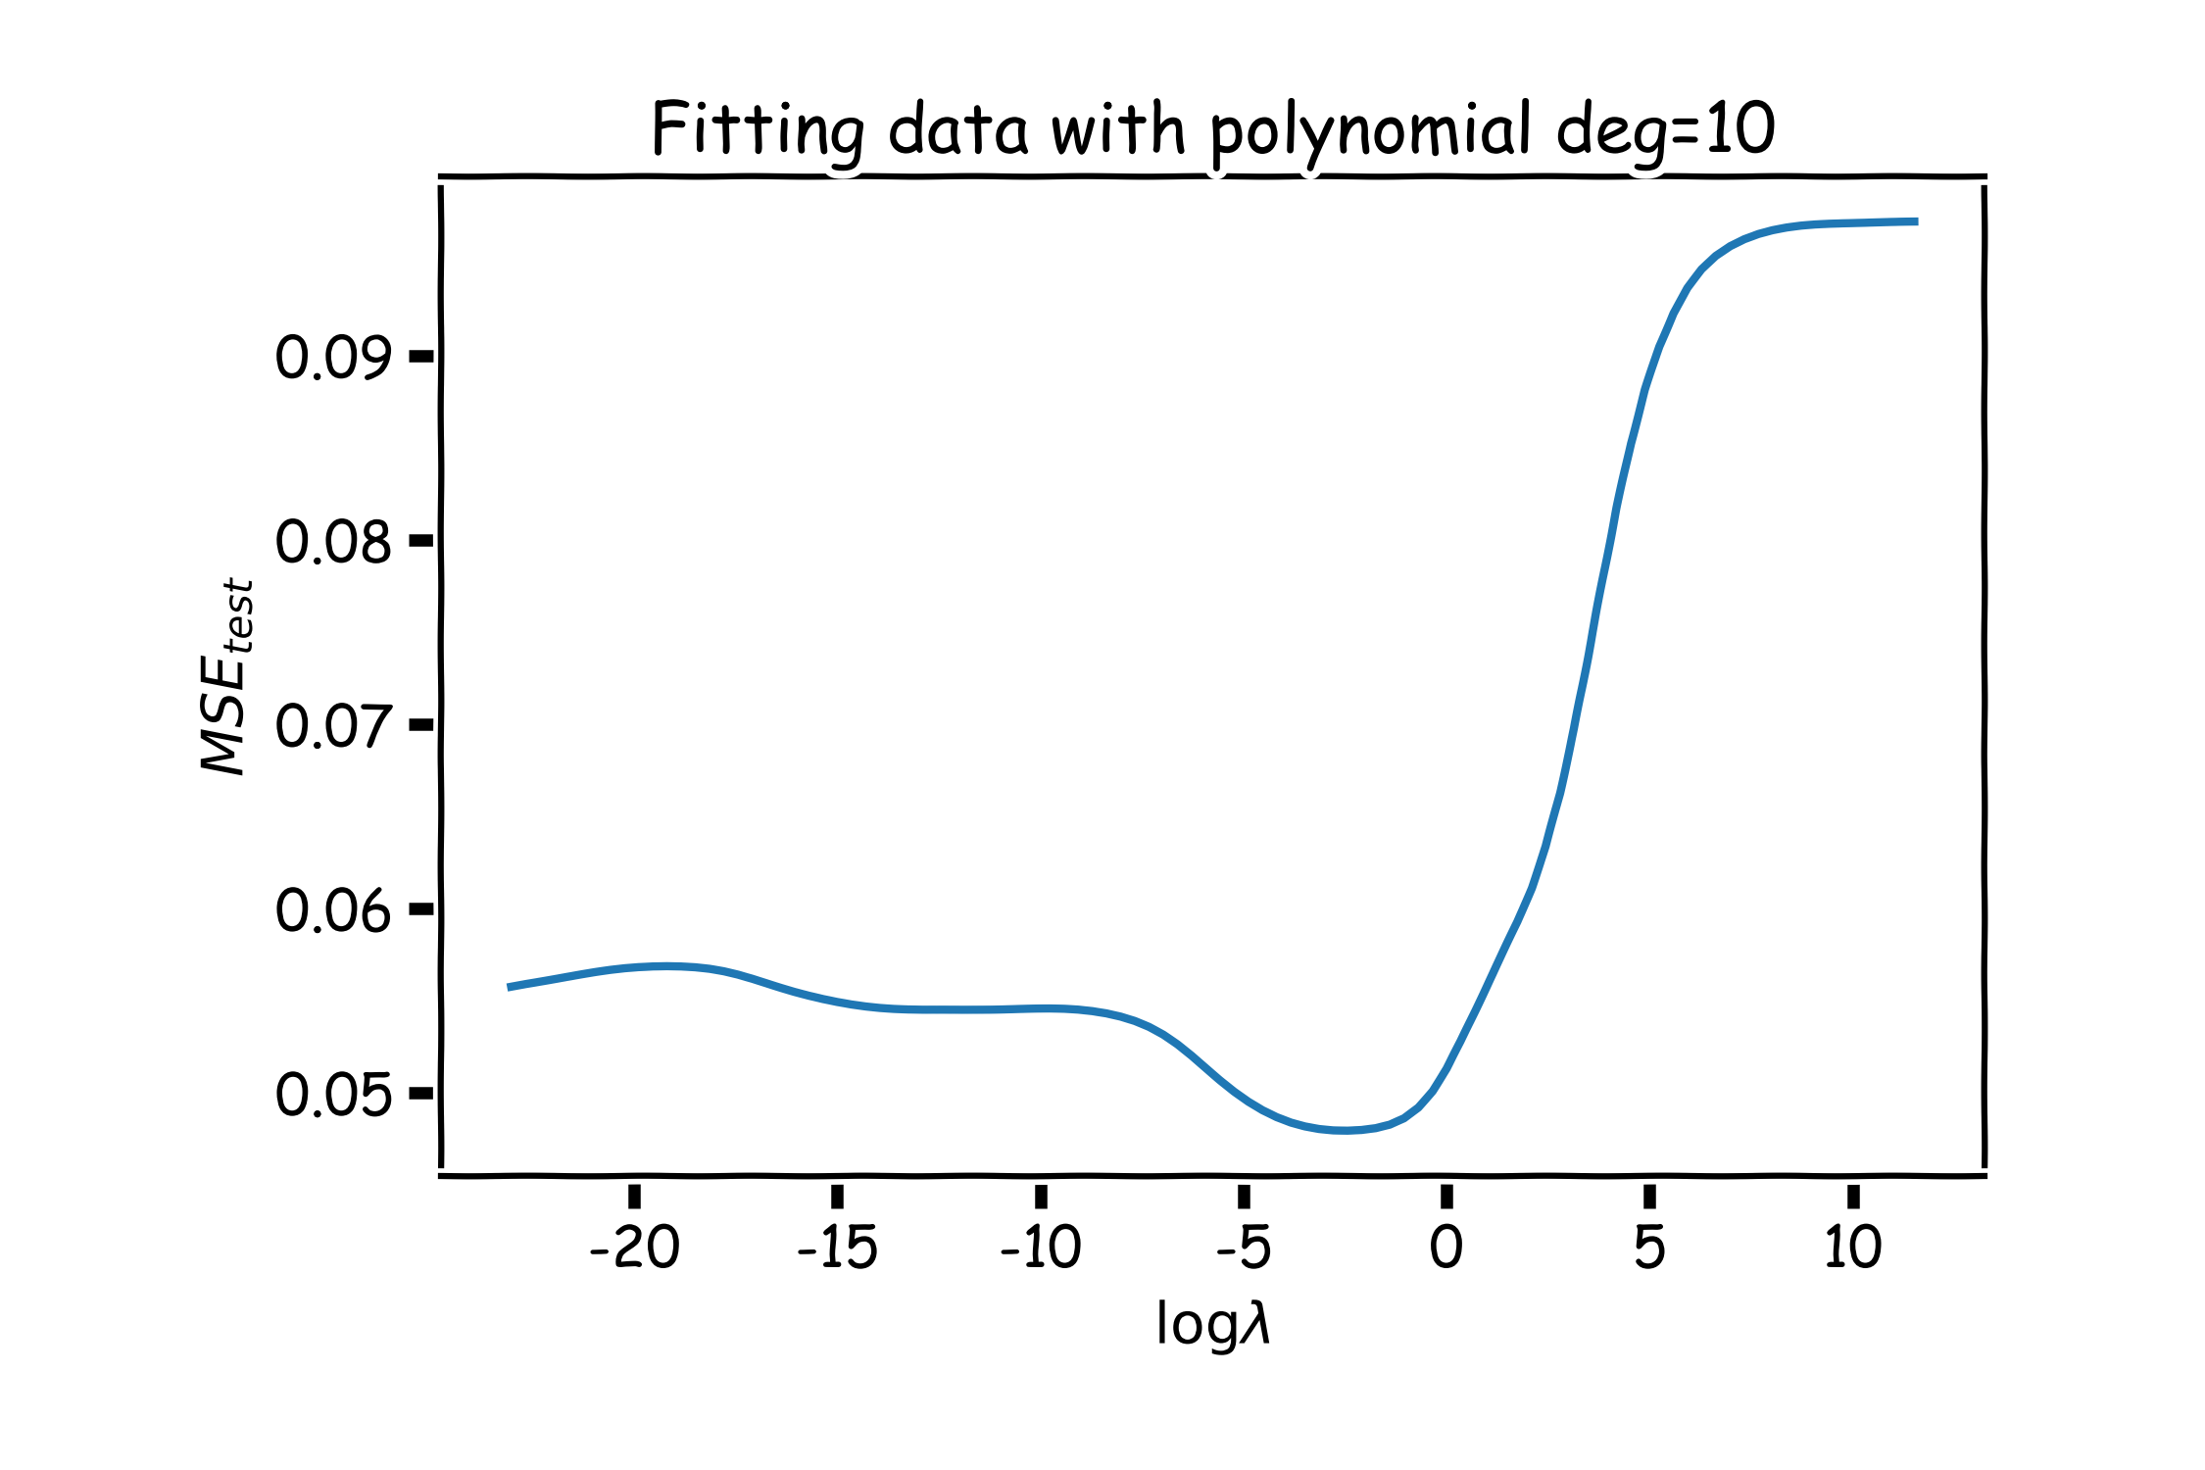
Ridge regularization with validation only: step by step

Slide 47
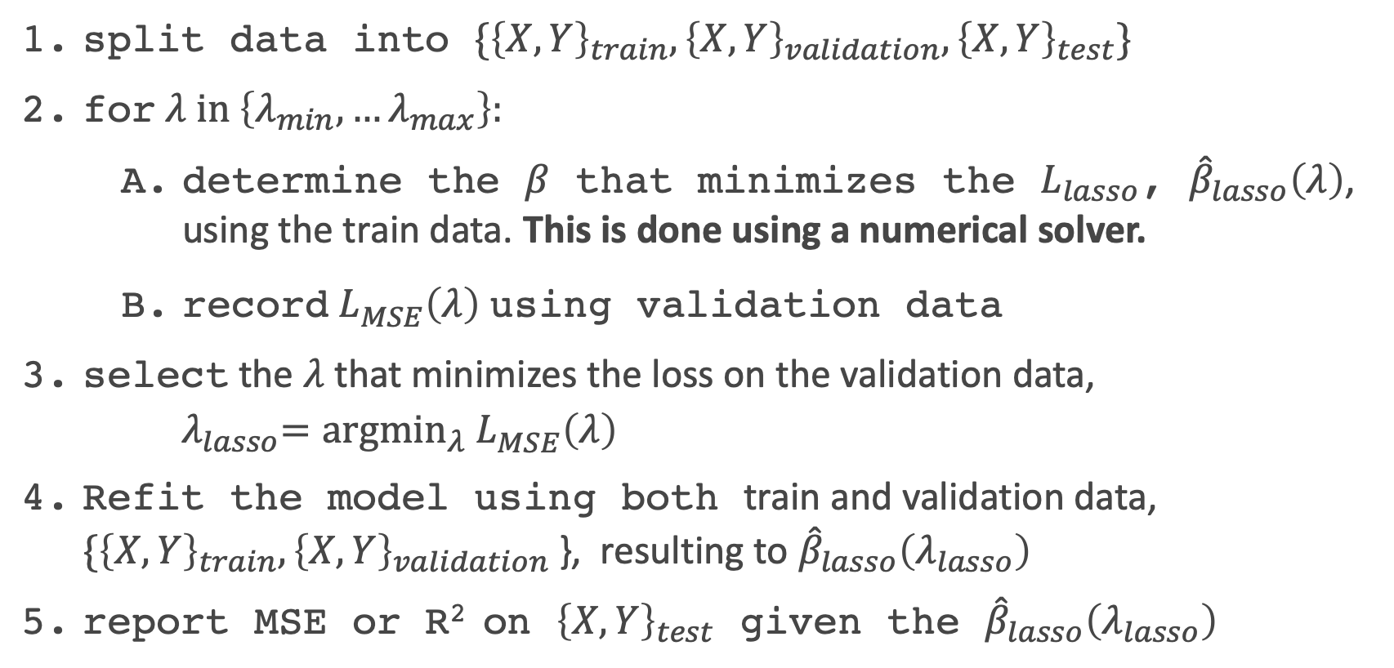
Lasso regularization with validation only: step by step
split data into $\{{\left\{X,Y\right\}}_{train},{\left\{X,Y\right\}}_{validation},{\left\{X,Y\right\}}_{test}\}$
for $λ in \left\{λ_{min},…λ_{max}\right\}:$
determine the $β$ that minimizes the $L_{lasso}$, ${\hat{β}}_{lasso}\left(λ\right)$, using the train data. This is done using a numerical solver.
record $L_{MSE}^{}\left(λ\right)$ using validation data
select the $λ$that minimizes the loss on the validation data, ${ λ}_{lasso}={argmin}_{λ} L_{MSE}^{}\left(λ\right)$
Refit the model using both train and validation data, $\{{\left\{X,Y\right\}}_{train},{\left\{X,Y\right\}}_{validation}$ }, resulting to ${\hat{β}}_{lasso}\left(λ_{lasso}\right)$
report MSE or R² on ${\left\{X,Y\right\}}_{test}$ given the ${\hat{β}}_{lasso}\left(λ_{lasso}\right)$

Slide 48
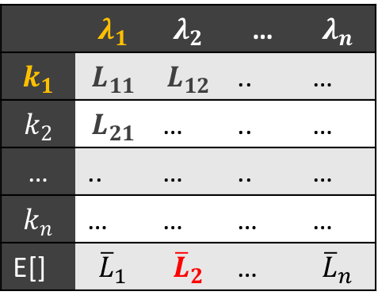
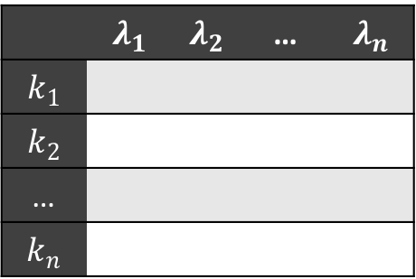
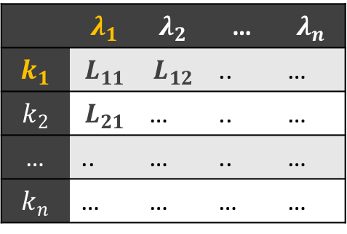





Ridge regularization with CV: step by step
 | $$λ_{1}$$ | $$λ_{2}$$ | … | $$λ_{n}$$
$$k_{1}$$
$$k_{2}$$
…
$$k_{n}$$
 | $$λ_{1}$$ | $$λ_{2}$$ | … | $$λ_{n}$$
$$k_{1}$$ | $$L_{11}$$ | $$L_{12}$$ | .. | …
$$k_{2}$$ | $$L_{21}$$ | … | .. | …
… | .. | … | .. | …
$$k_{n}$$ | … | … | … | …
E[] | $${\overline{L}}_{1}$$ | $${\overline{L}}_{2}$$ | … | $${\overline{L}}_{n}$$
 | $$λ_{1}$$ | $$λ_{2}$$ | … | $$λ_{n}$$
$$k_{1}$$
$$k_{2}$$
…
$$k_{n}$$
 | $$λ_{1}$$ | $$λ_{2}$$ | … | $$λ_{n}$$
$$k_{1}$$ | $$L_{11}$$ | $$L_{12}$$ | .. | …
$$k_{2}$$ | $$L_{21}$$ | … | .. | …
… | .. | … | .. | …
$$k_{n}$$ | … | … | … | …
 | $$λ_{1}$$ | $$λ_{2}$$ | … | $$λ_{n}$$
$$k_{1}$$ | $$L_{11}$$
$$k_{2}$$
…
$$k_{n}$$
 | $$λ_{1}$$ | $$λ_{2}$$ | … | $$λ_{n}$$
$$k_{1}$$ | $$L_{11}$$ | $$L_{12}$$ | .. | …
$$k_{2}$$ | $$L_{21}$$ | … | .. | …
… | .. | … | .. | …
$$k_{n}$$ | … | … | … | …
E[] | $${\overline{L}}_{1}$$ | $${\overline{L}}_{2}$$ | … | $${\overline{L}}_{n}$$
 | $$λ_{1}$$ | $$λ_{2}$$ | … | $$λ_{n}$$
$$k_{1}$$
$$k_{2}$$
…
$$k_{n}$$
remove ${\left\{X,Y\right\}}_{test}$ from data
split the rest of data into K folds, $\{{\left\{X,Y\right\}}_{train}^{−k},{\left\{X,Y\right\}}_{val}^{k}\}$
for k in $\left\{1,…,K\right\}$
for $λ in \left\{λ_{0,}…{, λ}_{n}\right\}:$
determine the $β$ that minimizes the $L_{ridge}$, ${\hat{β}}_{ridge}\left(λ,k\right)={\left(X^{T}X+λI\right)}^{−1}X^{T}Y$ , using the train data of the fold, ${\left\{X,Y\right\}}_{train}^{−k}$.
record $L_{MSE}^{}\left(λ,k\right)$ using the validation data of the fold ${\left\{X,Y\right\}}_{val}^{k}$
At this point we have a 2-D matrix, rows are for different k, and columns are for different $λ$ values.
Average the $L_{MSE}(λ,k)$ for each $λ$, ${{\overline{L}}_{MSE}\left(λ\right)}_{}$.
Find the $λ$ that minimizes the ${{\overline{L}}_{MSE}\left(λ\right)}_{}$, resulting to $λ_{ridge}$.
Refit the model using the full training data, $\{{\left\{X,Y\right\}}_{train},{\left\{X,Y\right\}}_{val}$ }, resulting to ${\hat{β} }_{ridge}\left(λ_{ridge}\right)$
report MSE or R² on ${\left\{X,Y\right\}}_{test}$ given the ${\hat{β}}_{ridge}\left(λ_{ridge}\right)$

Slide 49

Ridge regularization with validation only: step by step

Slide 50

Variable Selection as Regularization
Since LASSO regression tend to produce estimates of zero (${\hat{β}}_{j}=0$) for a number of model parameters - we say that LASSO solutions are sparse – from this perspective, LASSO can be considered a method for variable selection.
Many prefer using LASSO for variable selection (as well as for suppressing extreme parameter values) rather than stepwise selection, as LASSO avoids the sequential algorithm that arises in stepwise selection (tuning can be done in parallel).
Question: What are the pros and cons of the two approaches?

Slide 51
Ridge vs. Lasso vs. Variable Selection: which is better?
So there are 3 different approaches (so far) to dealing with high dimensional data (a large # predictors, p). Which choice wins out?
As you might imagine, it depends on the setting!
Sequential Variable Selection: does really well when there are only a few strong predictors. But is slow.
Ridge: does really well when there are a lot of weak to moderately strong predictors.
Lasso: does really well when there is a mix of useless predictors and moderate to strong predictors.

Slide 52

Elastic Net Regularization: the best of both worlds?
We will not get into the details here, but there is a blended approach of Ridge and LASSO called Elastic Net.
It estimates the coefficient by minimizing the loss function:
A grid-search cross-validation can then be used to determine the best choices of the 2 penalty terms in this loss function (this idea comes in handy in future models).
$$\hat{β}≡\underset{β}{argmin}\left(∑{\left(y−Xβ\right)}^{2}+λ_{2}∑β^{2}+λ_{1}∑|β|\right)$$

Slide 53
Why Cross-Validation?

